Slide 1
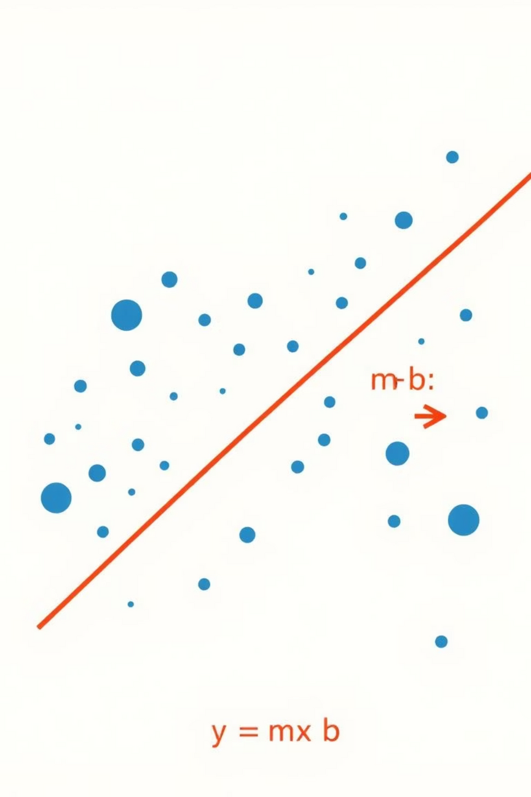

Linear Regression
Predicting the Future, One Line at a Time

Slide 2
What is Linear Regression?
Supervised Learning
Best Fit Line
A fundamental supervised learning algorithm used for predictive modeling.
It identifies the optimal straight line that best represents the relationship between data points.
Continuous Prediction
Input-Output Relationship
Its primary goal is to predict continuous values, such as prices, temperatures, or sales figures.
It clearly demonstrates the linear relationship between input (X) and output (Y) variables. The equation is Y = mX + b, where 'm' is the slope and 'b' is the Y-intercept.

Slide 3

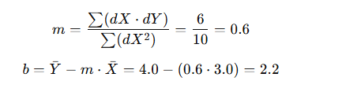
X | Y | X̄=3 | Ȳ=4 | dX=X−3 | dY=Y−4 | dX × dY | dX^2
1 | 2 | 3 | 4 | -2 | -2 | 4 | 4
2 | 4 |  |  | -1 | 0 | 0 | 1
3 | 5 |  |  | 0 | 1 | 0 | 0
4 | 4 |  |  | 1 | 0 | 0 | 1
5 | 5 |  |  | 2 | 1 | 2 | 4

Slide 4
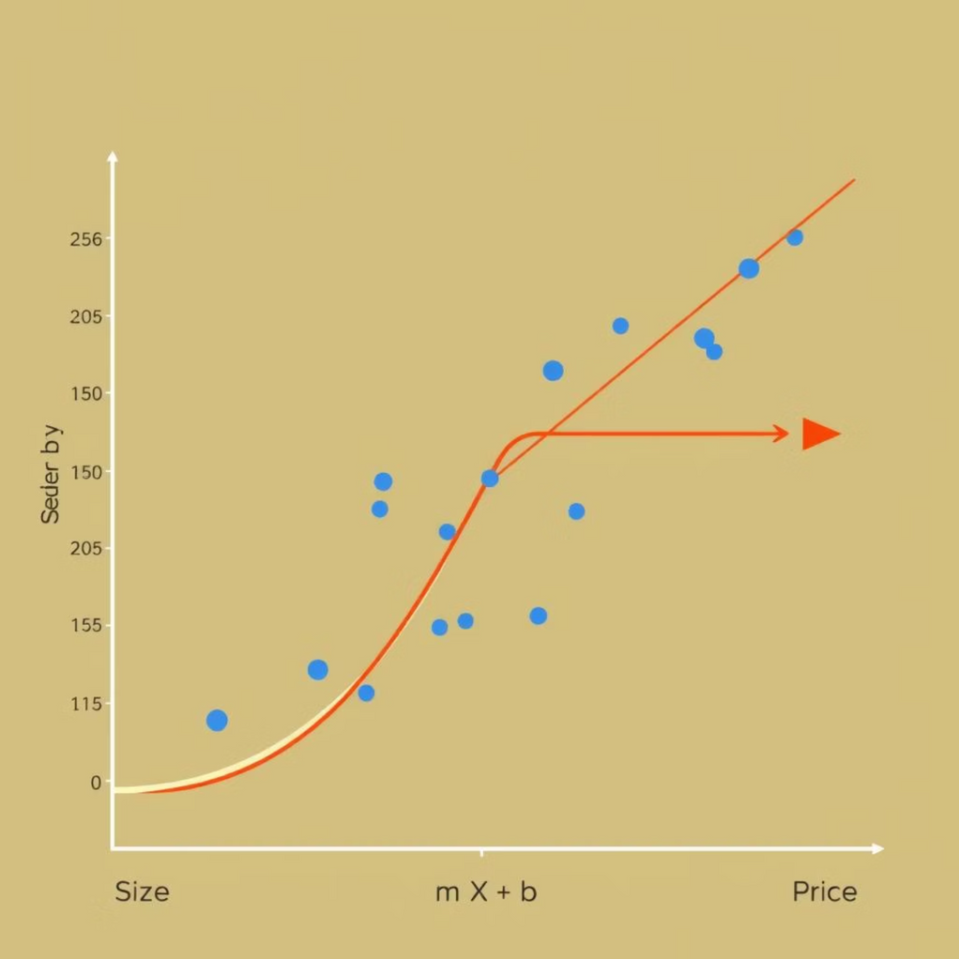
Applications in AI & ML
Real Estate: Predicting house prices based on features like size, location, and number of bedrooms.
Finance: Forecasting sales, stock prices, or market trends to inform investment strategies.
Natural Language Processing: Used for text-based predictions and sentiment analysis in various NLP tasks.
Linear regression also serves as a foundational algorithm for model evaluation and comparison in machine learning, providing a baseline for more complex models.

Slide 5
Understanding Loss and Its Importance
1
2
Defining Loss
Guiding Model Improvement
Loss quantifies the error between your model's predicted output and the actual observed value. It's a measure of how "wrong" your predictions are.
Loss functions are crucial during training. By calculating the loss, the model understands where it needs to adjust its parameters to make more accurate predictions.
3
4
Mean Squared Error (MSE)
Mean Absolute Error (MAE)
The most common loss function for linear regression, MSE calculates the average of the squared differences between predicted and actual values. It penalizes larger errors more heavily.
MAE calculates the average of the absolute differences. It's less sensitive to outliers and often preferred when large errors are not disproportionately critical.

Slide 6
Hyperparameters: Tuning for Performance
Hyperparameters are configuration settings external to the model, whose values are set before the training process begins. They significantly influence how the model learns and its overall performance.
1
2
3
Learning Rate
Batch Size
Number of Iterations
Determines the step size taken during each iteration of Gradient Descent.
The number of training examples utilized in a single iteration.
How many times the model will go through the entire training dataset.
Properly tuning these hyperparameters is crucial for achieving high accuracy and efficient training. Incorrect settings can lead to suboptimal models or prolonged training times.
Notes:
Learning rate is like how big your steps are when walking toward your goal.
Epochs are how many times you read the full book.
Batch size is how many pages you read before taking notes.

Slide 7
Batch Size & Learning Rate Explained
Batch Size
Learning Rate
The number of training samples processed before the model's internal parameters are updated. This affects training speed and the stability of the gradient updates.
A crucial hyperparameter that dictates the magnitude of parameter updates during each iteration of Gradient Descent. It controls how quickly the model learns.
Small Batch: Slower training, but often leads to more accurate and stable convergence, as updates are based on a more detailed view of the data.
Too High: The model may overshoot the optimal solution, causing oscillations or divergence, leading to poor results.
Too Low: Training becomes exceedingly slow, requiring many iterations to converge, potentially getting stuck in local minima.
Large Batch: Faster training, but may generalize less effectively and sometimes miss intricate patterns in the data.

Slide 8

Gradient Descent: Optimizing the Model
Gradient Descent is an iterative optimization algorithm used to minimize the loss function of a model. It helps the model find the optimal weights (slope 'm' and intercept 'b') that result in the lowest possible error.
Step-by-Step Adjustment: It systematically adjusts the model's parameters in the direction that reduces the loss.
Finding the "Bottom": Imagine descending a hill; each step moves you closer to the lowest point, which represents the best fit line for the data.
Essential for Learning: Without Gradient Descent, a linear regression model would not be able to learn from its errors or improve its predictive accuracy during training.

Slide 9



Key Takeaways
Predictive Power
Optimization Core
Hyperparameter Mastery
Linear regression excels at predicting continuous values, making it invaluable in diverse fields like finance and healthcare.
Loss functions quantify error, while Gradient Descent efficiently minimizes it, ensuring the model continually improves its accuracy.
Strategic tuning of hyperparameters like learning rate and batch size is key to optimizing model speed and accuracy.

Slide 10
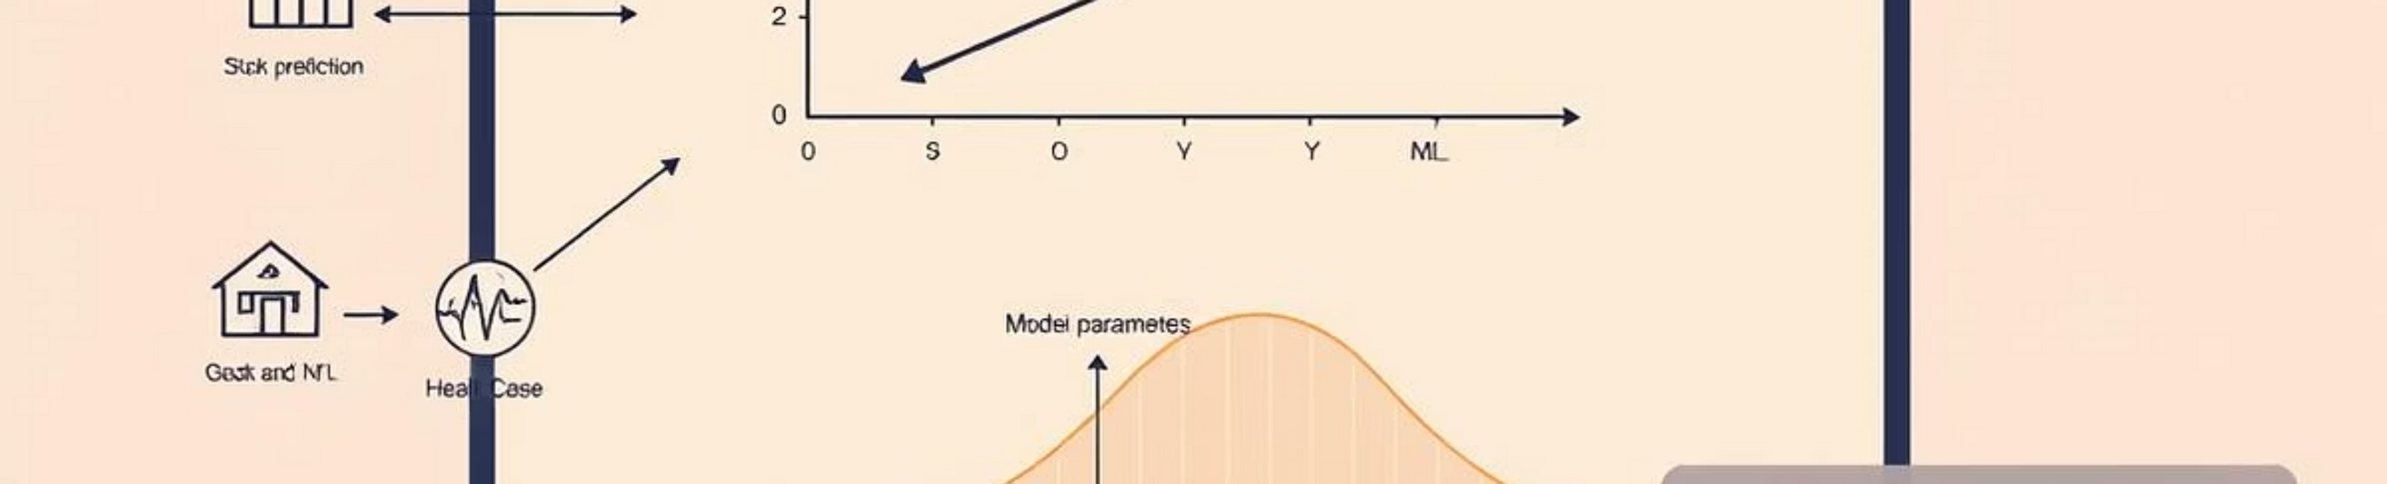


Next Steps
Further Learning
Practical Application
Explore advanced regression techniques like polynomial regression or logistic regression for more complex datasets.
Apply linear regression to a real-world dataset. Consider using libraries like Scikit-learn in Python to build your first model.

